Slide 1
ROCKBUSTER STEALTH MARKET ANALYSIS
Presented by
Ivan Tzesnits

Slide 2
Introduction and objectives
Objective:
• Which movies contributed the most/least to revenue gain?
• What was the average rental duration for all videos?
• Which countries are Rockbuster customers based in?
• Where are customers with a high lifetime value based?
• Do sales figures vary between geographic regions?
• What are the most popular movie genres?
Determine the most profitable movies and regions that should be prioritized when switching to the online platform
About:
Rockbuster Stealth LLC is a movie rental company that used to have stores around the world.
Facing stiff competition from streaming services, the Rockbuster Stealth management team is planning to use its existing movie licenses to launch an online video rental service in order to stay competitive.

Slide 3
DATA OVERVIEW
Movies
Customers
Rentals
1000 Movies
17 Genres
5 MPAA RATING
Movies released in 2006
584 Active users
109 countries
599 cities
$ 61312 total revenue
16044 total rentals

Slide 4
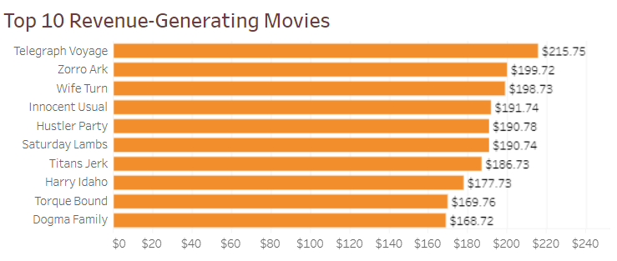
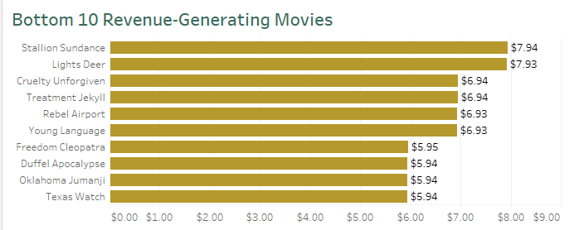
movie CONTRIBUTION TO REVENUE
TOP 50 movies made 13% of global revenue
Bottom 50 movies made 1% of global revenue

Slide 5
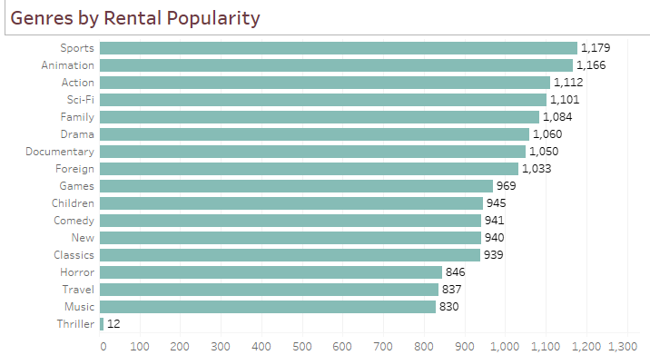
Genre popularity
Sports generated highest percentage of revenue
Thriller on the other hand generated least revenue, but we need to keep in mind that there was only 1 movie under Thriller genre

Slide 6
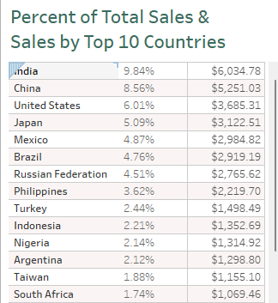
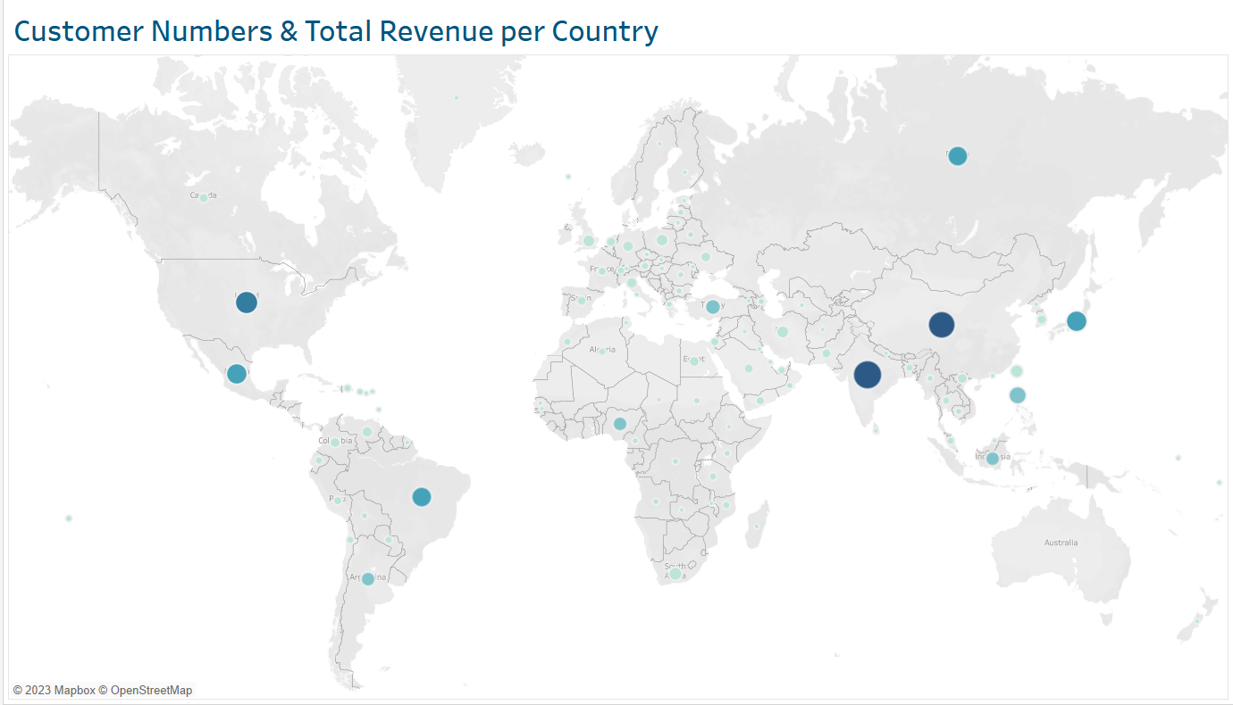
Spatial analysis

Slide 7
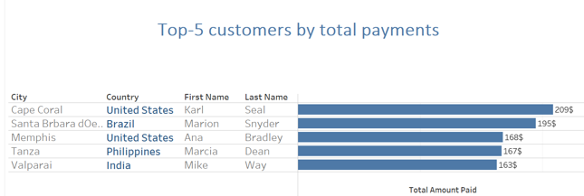
LTV of customers
102$ was the AVG amount spent by customers wordwide

Slide 8
Recommendations
Movies that don't make a lot of money (the Bottom 50 or even more) should be removed from the inventory.
When launching the internet platform, give North and South America, Asia, and Europe top priority.
Free rentals should be offered to customers with high value. Some affiliate programs might also bring in more money.
Examine countries with a single customer to ascertain the causes of the low sales of the company's items there.
Consider conducting a poll of current consumers to learn more about their product preferences, then modifying the present movie collection based on the results.

Slide 9
THANK YOU
Tableau link

